Slide 1


Slide 2
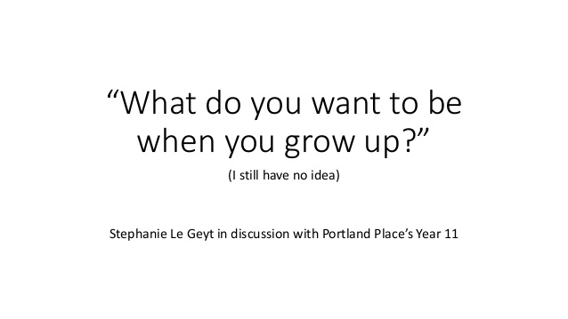
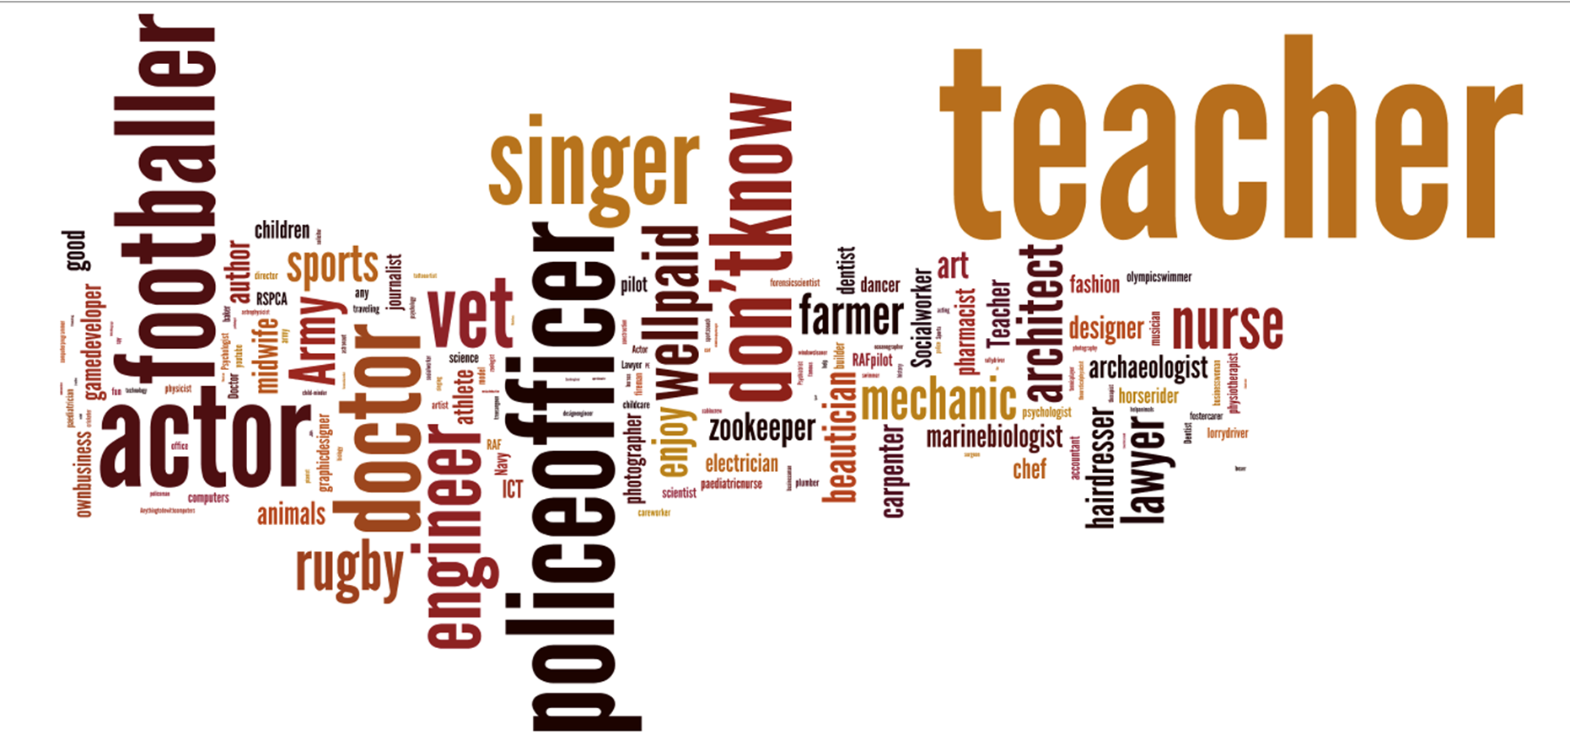

Slide 3


Slide 4



Slide 5

Rule R277-915. Work-based Learning Programs
R277-915-2. Definitions.
  (5) "Work-based learning" or "WBL" means a continuum of awareness, exploration, preparation, and training activities that combine structured learning and authentic work experiences implemented through industry and education partnerships.
  Workplace Skills (11-12) - 32.0199
  CTE Internships (11-12) - 32.9902
  Apprenticeship (11-12) - 32.9903

Slide 6

R277-915-4. Disbursement of Funds
(1) The Superintendent shall align public elementary, secondary, and postsecondary or adult schools by LEA.
(2) The proportion of total WBL funding allocated for a participating LEA shall remain the same as the previous year unless:
(a) the LEA discontinues the program;
(b) the LEA does not meet program standards; or
(c) LEA proportions are adjusted by the Board.
(3) A participating LEA shall provide an equal match
in funds to state appropriated WBL funds.

Slide 7
R277-915-5. Standards
1) WBL shall be integrated into all levels of the educational delivery system and shall be coordinated within the LEA and among regions.
(2) To be eligible for WBL funds, an LEA shall:
(a) have the program approved by the LEA board;
(b) employ licensed WBL coordination personnel with salaries and benefits matched by the local recipient of funds;
(c) document that a WBL committee representing all
schools within the LEA.

Slide 8
R277-915-5. Standards (cont’d)
(h) require the inclusion of all student groups within the LEA in career development and preparation;
(i) demonstrate WBL coordination with employers and with other school and community development activities.
(j) verify that sufficient budget for a WBL coordinator, facilities, materials, equipment, and support staff is available;
(k) participate in initial state-sponsored WBL coordinated professional development and in periodic ongoing coordination and professional development activities;
(l) require that the WBL team utilize a database system
developed by the LEA for the LEA's specific needs; and
(m) participate in the CTE Program Approval evaluation every
three years.

Slide 9
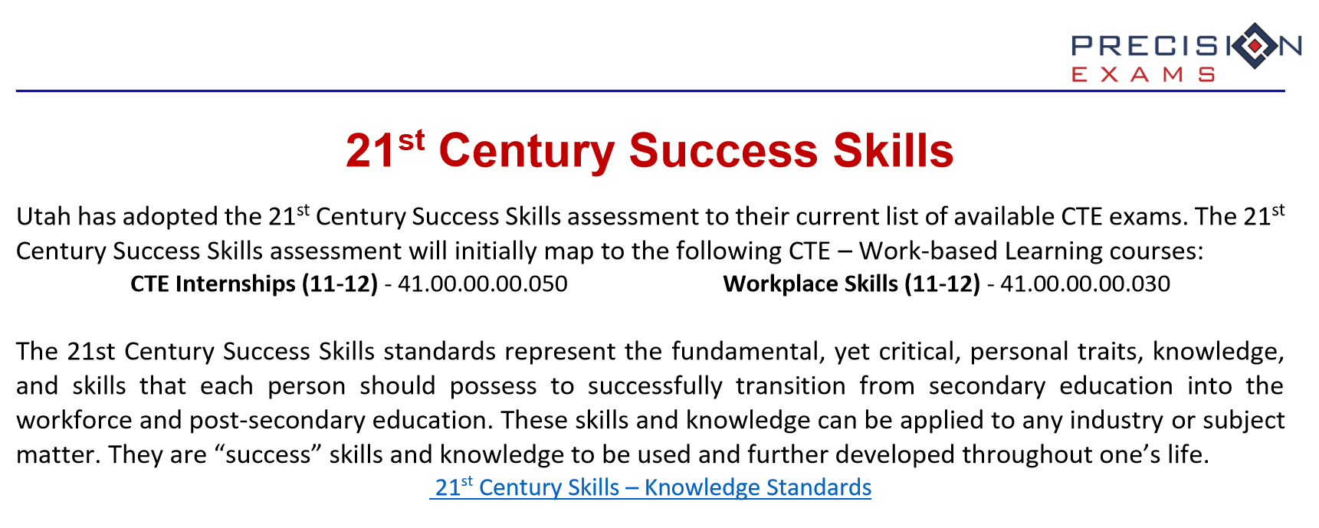
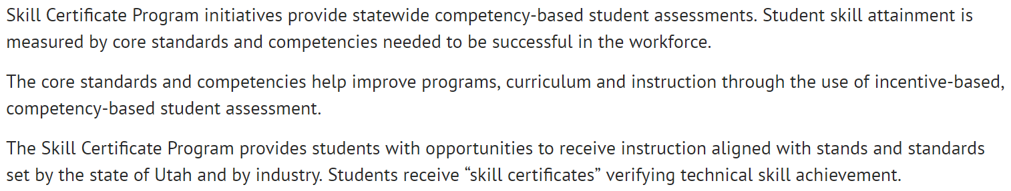

Slide 10
Utah WBL Models
Model A
CTE Pathway Capstone – Workplace Skills/CTE Internship
Model B
Workplace Skills Standalone Course – Work Experience/Leadership Cohort/Underemployed
Model C
Employment Ready – GOED/TRU/Externship
Model D
Community-based/Non-competitive or Ad hoc/referral Internships (not technically CTE related)

Slide 11


Slide 12
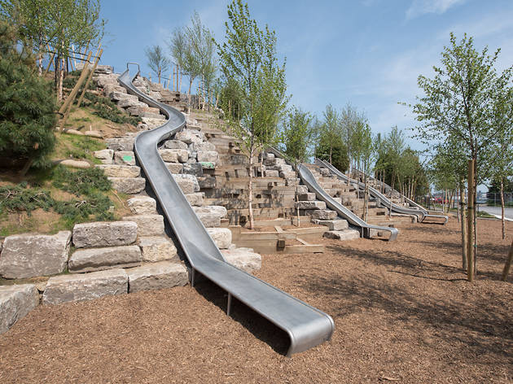
CTE Pathway Capstone – Workplace Skills/CTE Internship
By emphasizing -- or even requiring -- relevant jobs and internships as part of the undergraduate experience…[high schools]…set their graduates up to acquire good jobs after graduation in fields where their work is directly relevant to their undergraduate studies. And, as a result, these students recognize the value of their investment in their degree.

Slide 13
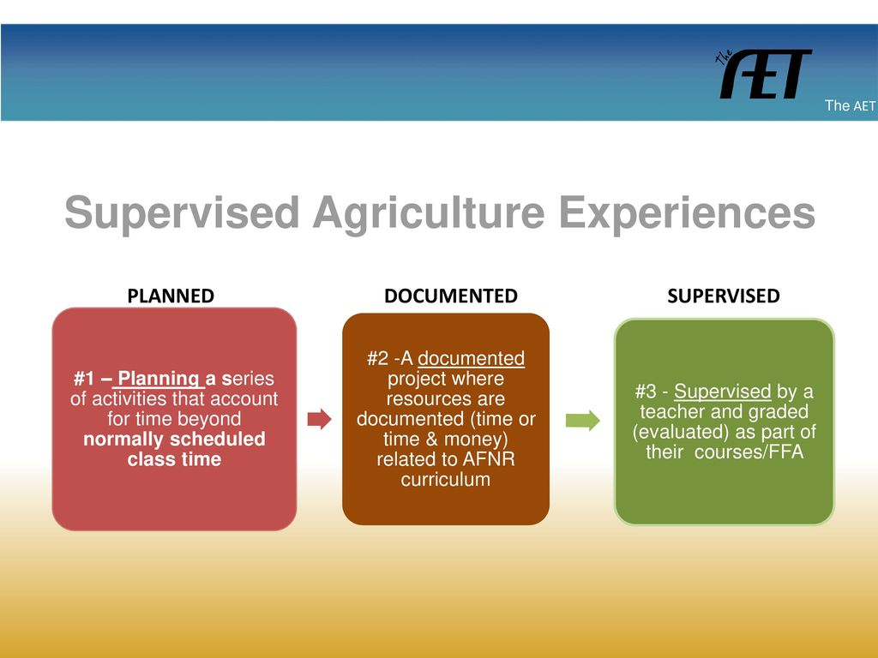

…all the practical agricultural activities of educational value conducted by students outside of class and laboratory instruction or on school-released time for which systematic instruction and supervision are provided by their teachers, parents, employers, or others.“
Notes:
Supervised Agricultural Experience: An Examination of Student Knowledge and Participation
According to findings of this study, 46.1% of the students surveyed reported having a SAE program (n = 473).

Slide 14
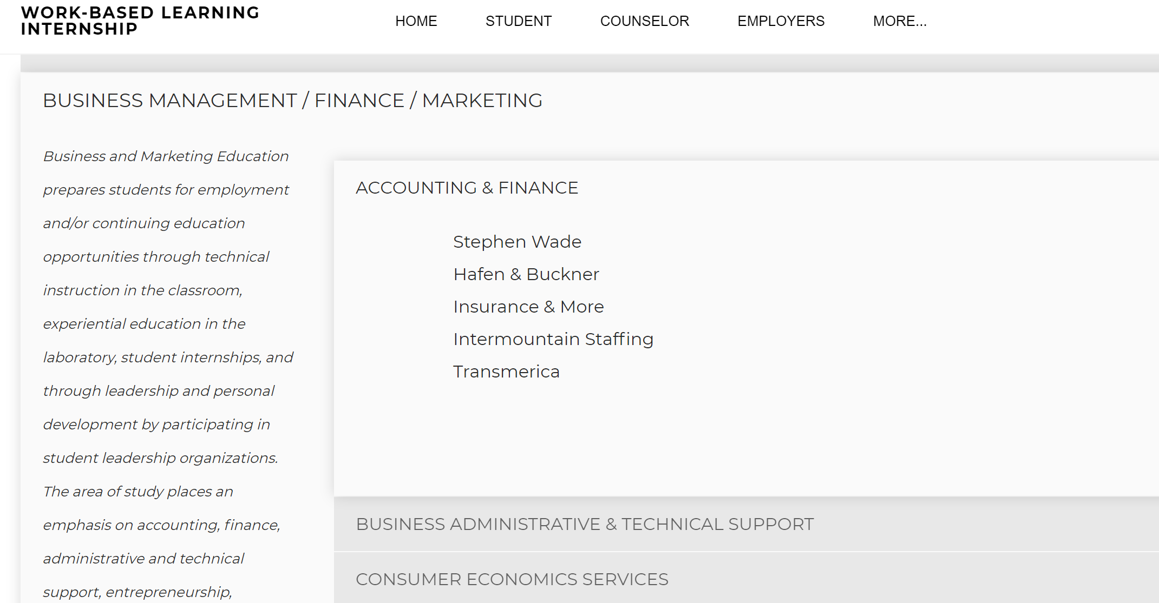
http://www.washk12internships.org/

Slide 15


Institutionalized WBL Capstone Experiences
Accounting & Finance
Accounting 1
Accounting 2
Advanced Accounting
Business Management
Business Mathematics and Personal Finance
Workplace Skills/Capstone

Slide 16



Slide 17
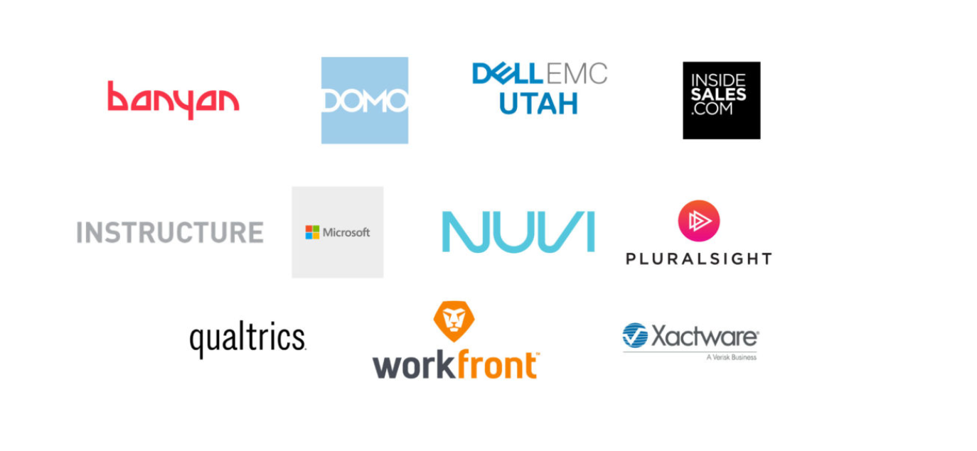

Slide 18


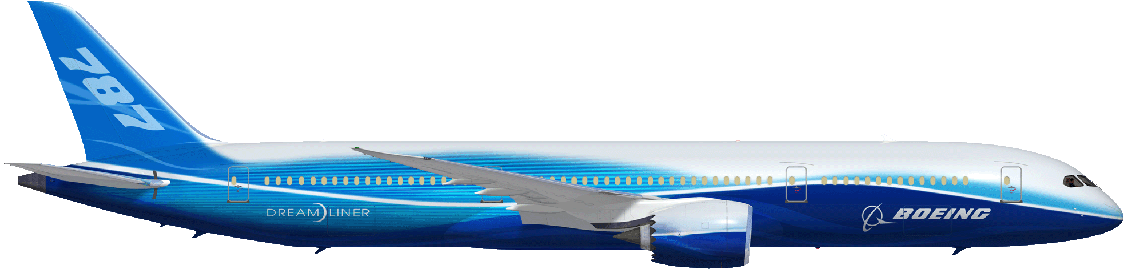
Utah Aerospace Pathways
Industry
Veterans
Internal
Movement
AEROSPACE EMPLOYMENT
Student Development Program
Engage
with student development programs
Targeted strategic outreach events
Internship
K – 8th Grade
Skill Center (11-12th)
Community/
Technical College
Traditional High School (9-12th)
4-Year College
Engage with career technical educators
Partner to address industry workforce development
needs
Developing the Future Manufacturing Workforce
Copyright © 2015 Boeing. All rights reserved.

Slide 19

Model D: Community-based/Non-competitive

Slide 20
A Case Against WBL For All Students
Pay interns.
Guarantee of a critical mass of qualified, willing employers.
Provide adequate resources to support internship programs.
CAPACITY
the maximum amount that something can contain.
the amount that something can produce.
a specified role or position.
With an estimated ratio of qualified and willing cooperating teachers of only 1 out of every 25, there are simply not enough high-quality classroom teachers available to serve as appropriate mentors to the next generation of teachers, particularly if we are serious about placing student teachers in high-performing schools serving children living in poverty. [2011]

Slide 21
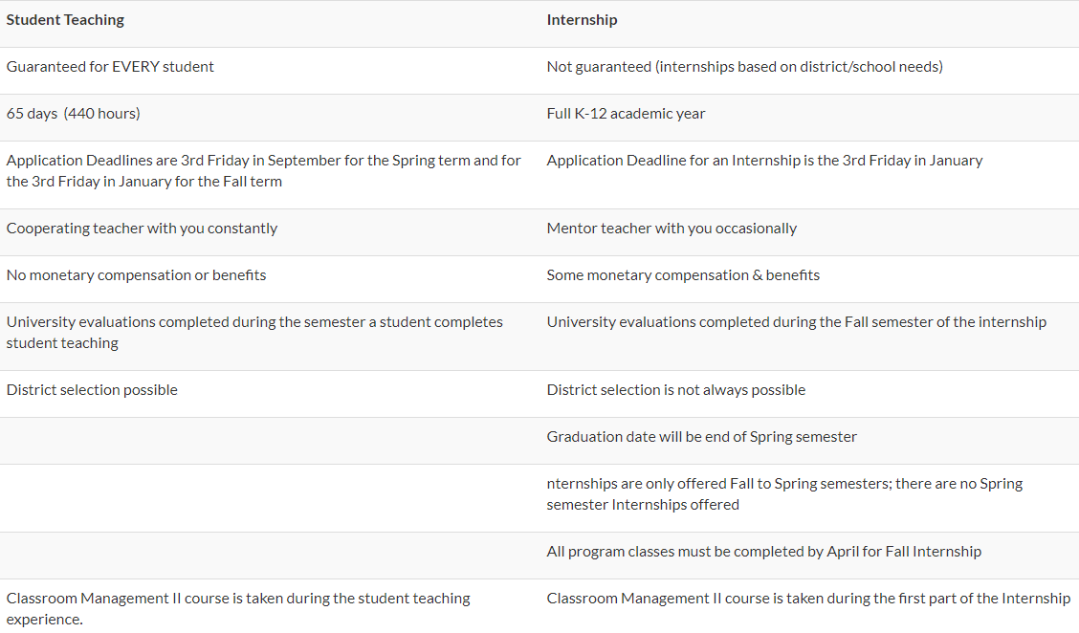

Slide 22


Slide 23



Slide 24



Slide 25

Policy Academy - Work-Based Learning
The National Governors Association Center for Best Practices (NGA Center), with support from the Siemens Foundation, is assisting states in scaling quality work-based learning programs for youth and young adults in STEM-intensive industries (those in the science, technology, engineering and math areas) such as advanced manufacturing, health care, information technology and energy.

Slide 26
NGA/WBL Phase I & Phase II
Launching statewide initiatives to raise awareness of work-based learning and embed these programs into education and training systems;
Securing state funding to support the expansion of work-based learning programs for educators and workers; and
Developing online portals to share information about work-based learning opportunities with state residents.

Slide 27
R277-705 Career Development Credentials
An LEA may award a career development credential to a student with an IEP or Section 504 plan:
(a) who meets the requirements of a career focused work experience prior to leaving
(b) complete 120 hours of community based work experience, to include:
40 hours of paid employment; (ii) documentation of completion of intake with a vocal rehabilitation counselor or the Department of Workforce Services;
(c) complete an LEA approved transition curriculum class or coursework that includes: (i) disability awareness; (ii) accommodations; (iii) self-advocacy training; (iv) career exploration; and (v) workplace soft skills;
(d) receive .5 credits in a CTE Work Based Learning internship, including accommodations or modifications as appropriate and allowed by industry standards; (e) verify concentration in a CTE pathway in the student’s area of interest.

Slide 28
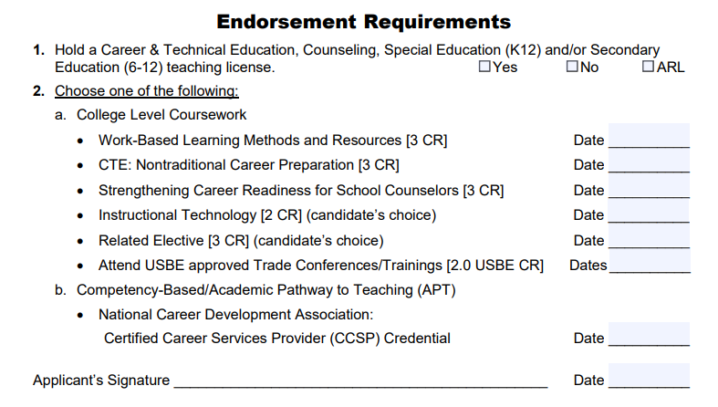

Slide 29

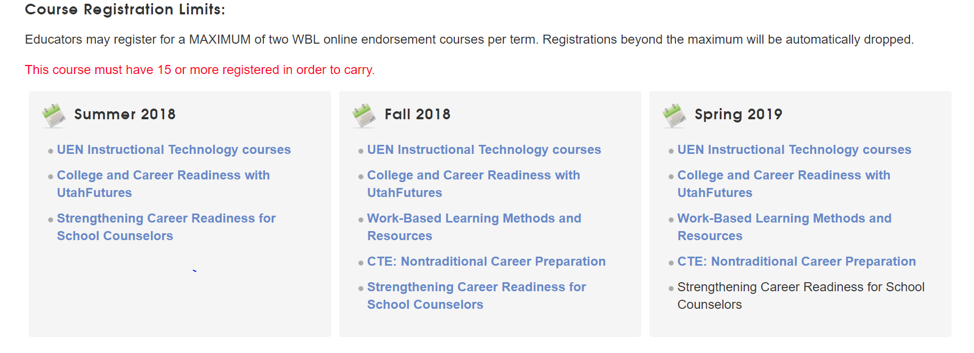

Slide 30
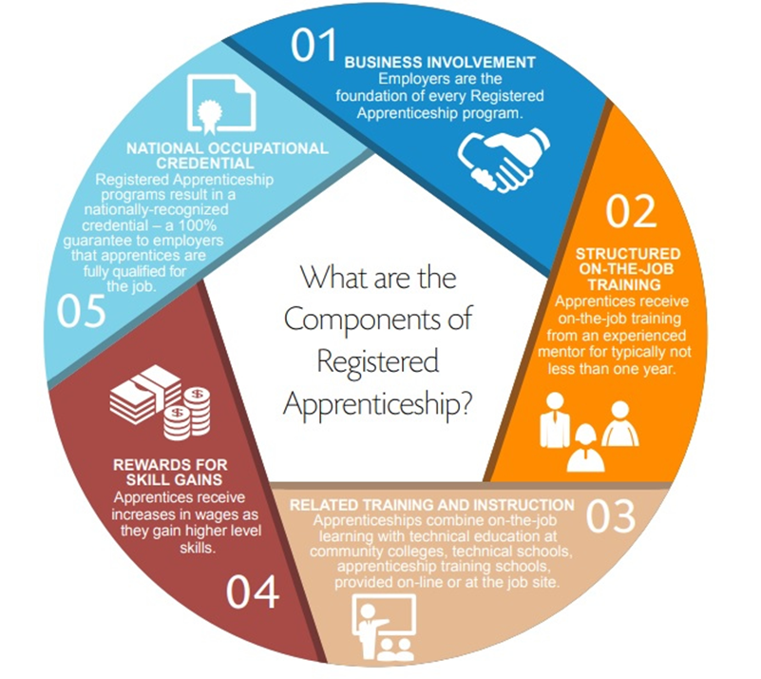
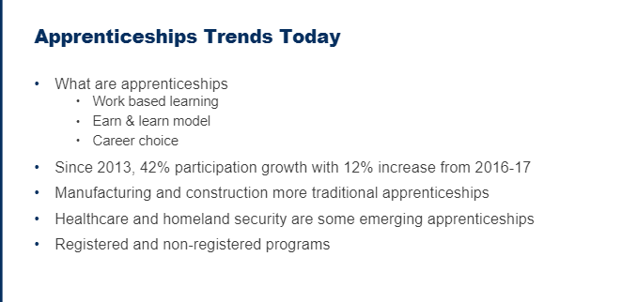
Apprenticeship

Slide 31


Slide 32
What would I do?
Ensure compliance with R277-915
Coordinate and leverage CCA course
Establish and implement a work experience policy
Establish pathway/cluster capstone opportunities
Establish standalone “workplace skills” courses (CE)
Develop a comprehensive WBL Portfolio
Establish a competitive or community-based internship program
Establish a mechanism for showing gratitude (students, teachers, parents, community, business & industry, etc.)
Always have an intern or two on staff (communications, public relations, etc.)

Slide 33
Utah College & Career Readiness Plan
Self-Assessments & Interest Inventories
Career & Educational Development Plan
Financial Literacy Plan
Resume/LinkedIn Account
Application for College
Application for Employment
Letters of Recommendation
Work Samples
Writing/Research Sample
Mock Interview Feedback

Slide 34
Background Check
Pre-employment Personality Testing
Pre-employment Medical Testing
Pre-employment Drug Testing
Pre-employment Credit Screening
Social Media Screening
New Employee Paperwork (I-9, W-4)
Benefits Forms
Salary Schedules
Nondisclosure Agreement (NDA)

